Slide 1

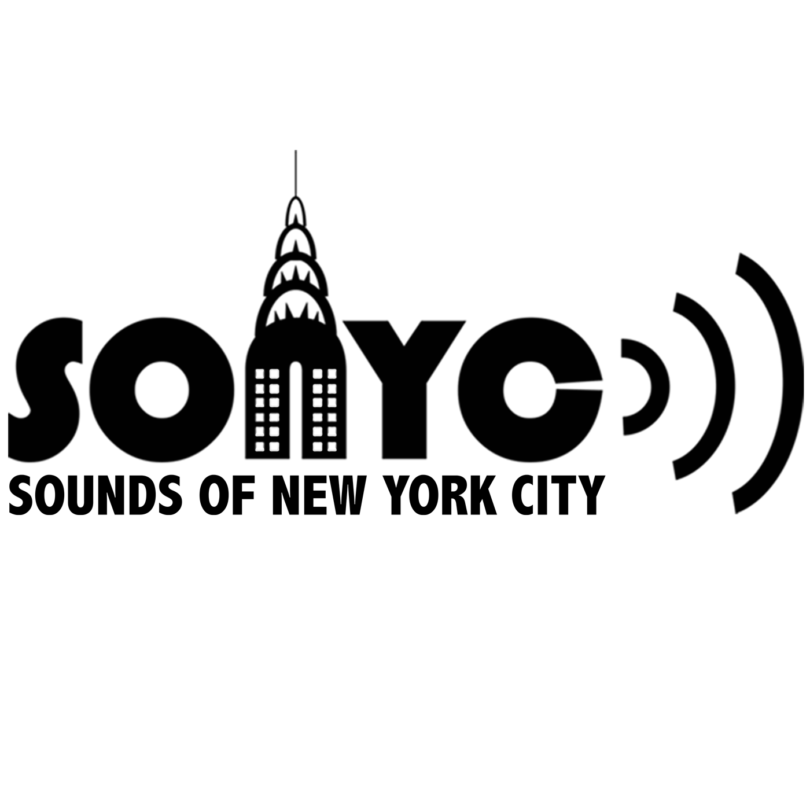
Summary of sensor data
(Report Date) .
Notes:
Thanks for participating
Here’s your personalized noise data report

Slide 2
Overview
Sounds of New York City (SONYC)

Slide 3
What is SONYC?
The Sounds of New York City or SONYC project, began in 2013 with the goal of understanding noise and its impact in urban environments. Over its duration we have deployed *(old SONYC = 75 deployed plus whatever we have done with SONYC Home)* advanced urban noise sensors across the city and collected 175 sensor years worth of decibel data.
In its latest version, called SONYC Home, we have collaborated with the Department of Environmental Protection (DEP) to design and build a sensor that people can mount outside their apartment windows to help quantify and report on their recurrent noise issues.
Notes:
How are you a part of it?
Background on decibels/how sound works, normal levels in rural vs suburban vs city setting
You are living in NYC, loudest city, here’s your participant info
“The objectives of SONYC are to create technological solutions for: (1) the systematic, constant monitoring of noise pollution at city scale; (2) the accurate description of acoustic environments in terms of its composing sources; (3) broadening citizen participation in noise reporting and mitigation; and (4) enabling city agencies to take effective, information-driven action for noise mitigation.”

Slide 4
Importance of Sound Health
Noise pollution is one of the topmost quality of life issues for urban residents in the United States. It has been estimated that 9 out of 10 adults in New York City (NYC) are exposed to excessive noise levels, i.e. beyond the limit of what the EPA considers to be harmful. When applied to U.S. cities of more than 4 million inhabitants, such estimates extend to over 72 million urban residents.
https://wp.nyu.edu/sonyc/#:~:text=Noise%20pollution%20is,million%20urban%20residents.
Long-term exposure to noise can cause a variety of health effects including annoyance, sleep disturbance, negative effects on the cardiovascular and metabolic system, as well as cognitive impairment in children.
https://www.eea.europa.eu/publications/environmental-noise-in-europe
https://www.eea.europa.eu/articles/noise-pollution-is-a-major#:~:text=Long%2Dterm%20exposure%20to%20noise,as%20cognitive%20impairment%20in%20children.
Notes:
How are you a part of it?
Background on decibels/how sound works, normal levels in rural vs suburban vs city setting
You are living in NYC, loudest city, here’s your participant info

Slide 5
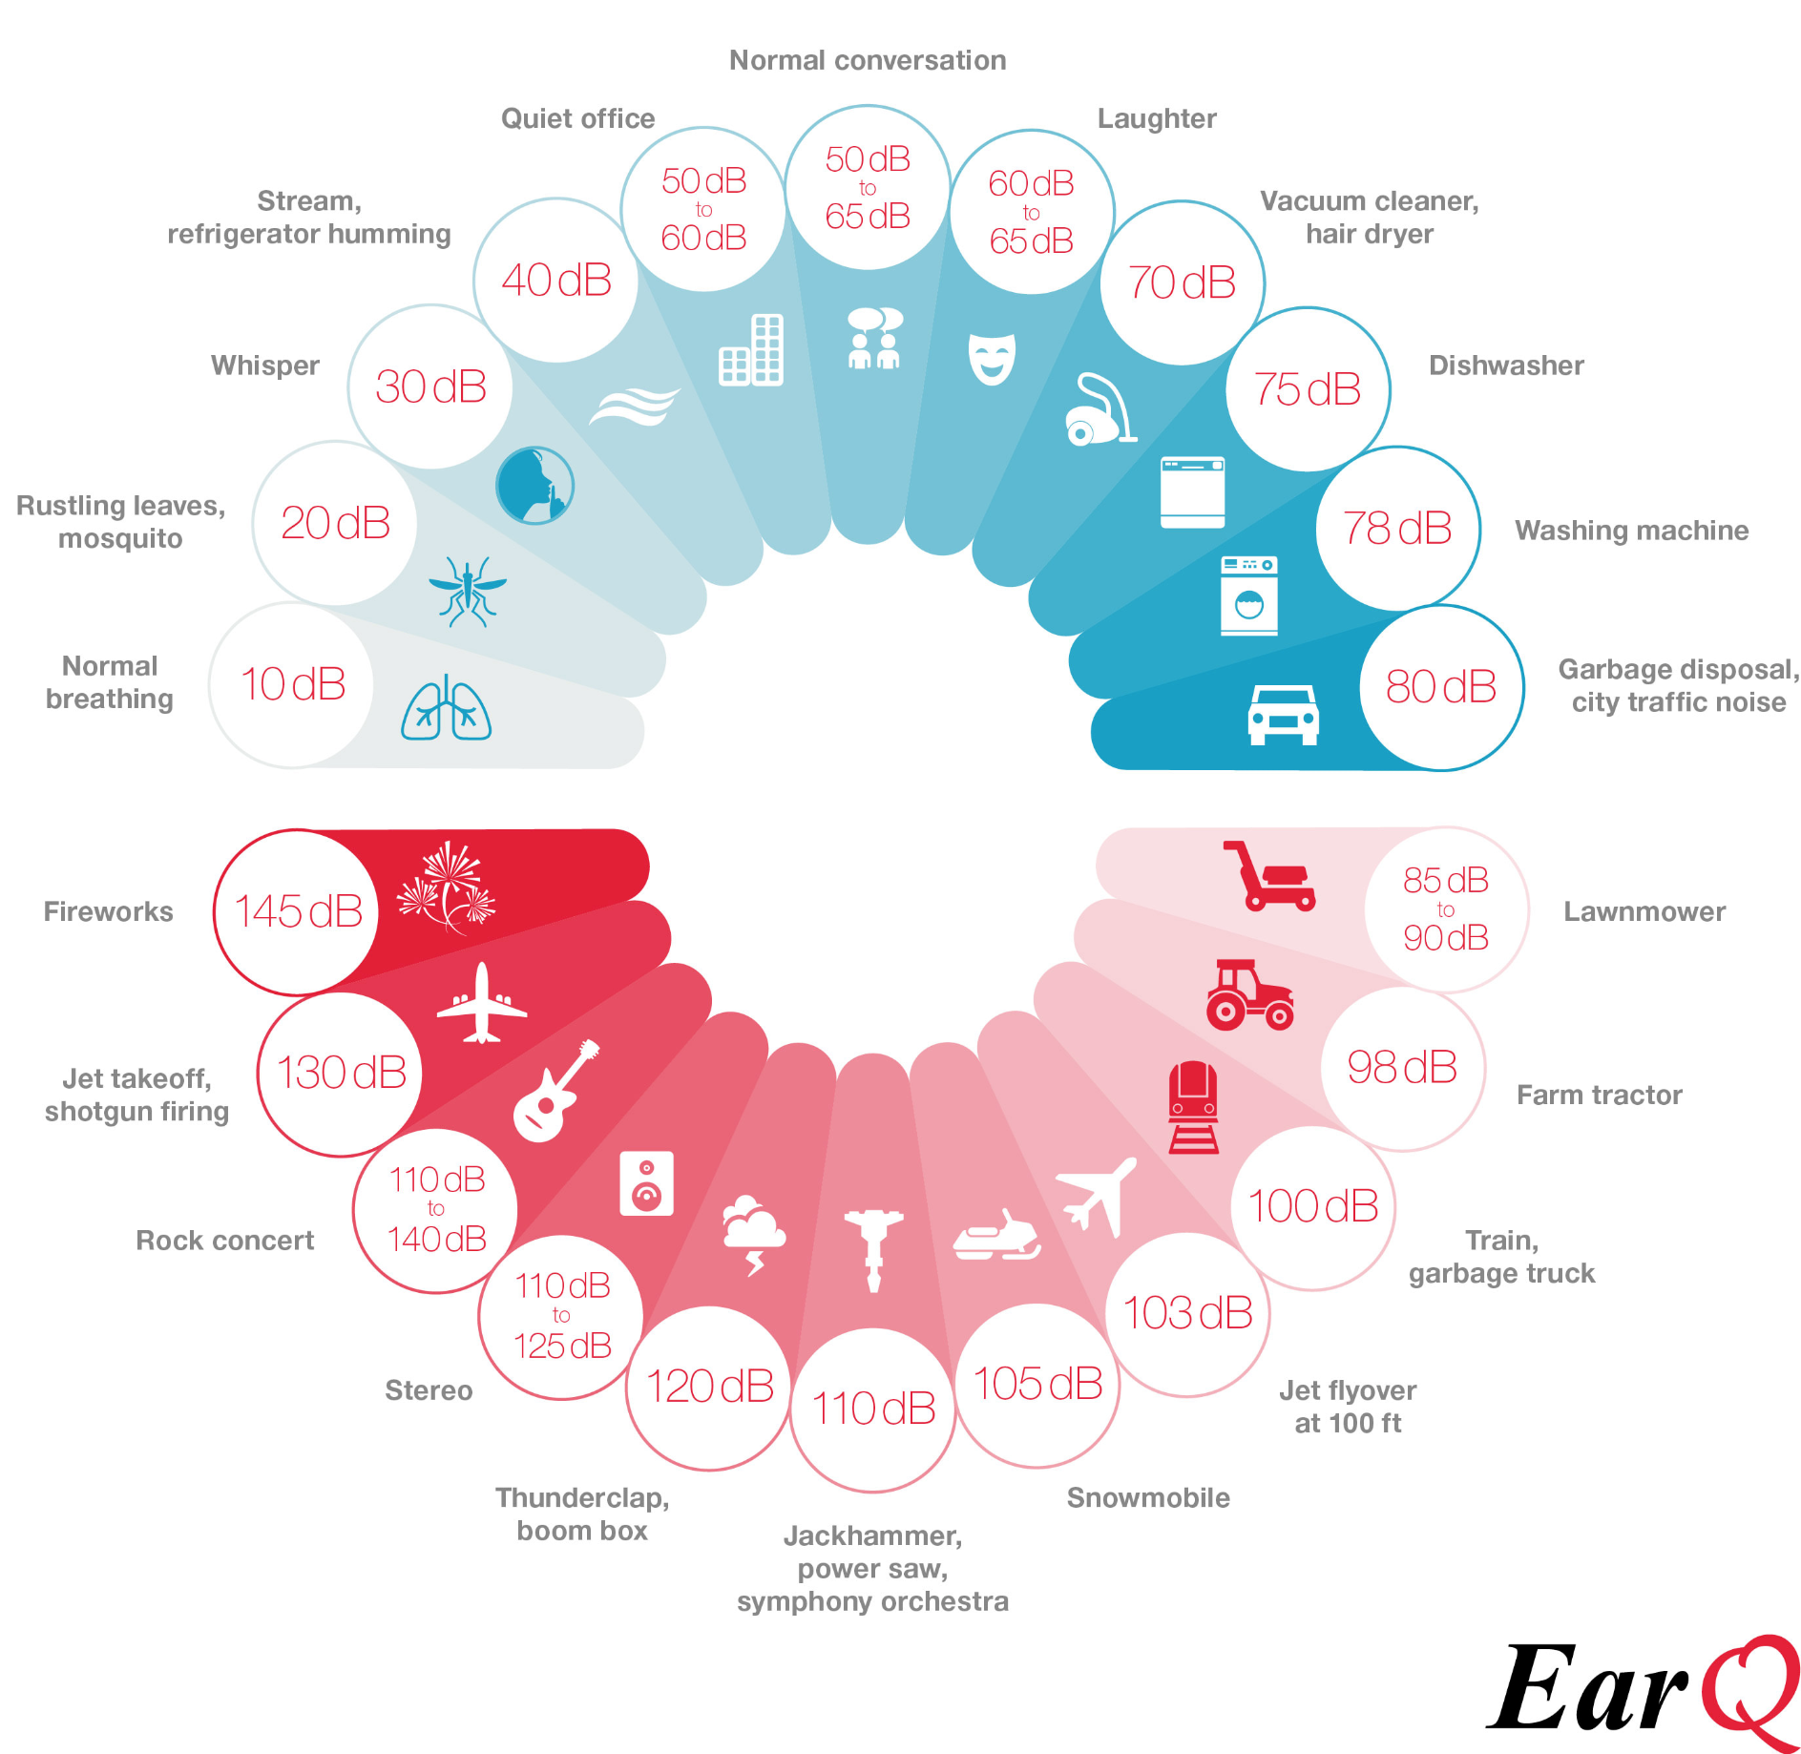
About Sound
A sound’s loudness, also referred to as the Sound Pressure Level (SPL), is measured in units of decibels (dB). The louder the sound, the higher the dB levels. The decibel scale is logarithmic, so an increase in 10 dB would equate to a sound being twice as loud.
More information about how metrics, statistics, and aggregations are included at the end of the report.
Notes:
How are you a part of it?
Background on decibels/how sound works, normal levels in rural vs suburban vs city setting
You are living in NYC, loudest city, here’s your participant info
10 db is doubling in level***
3db not LOUDNESS, sound energy double

Slide 6


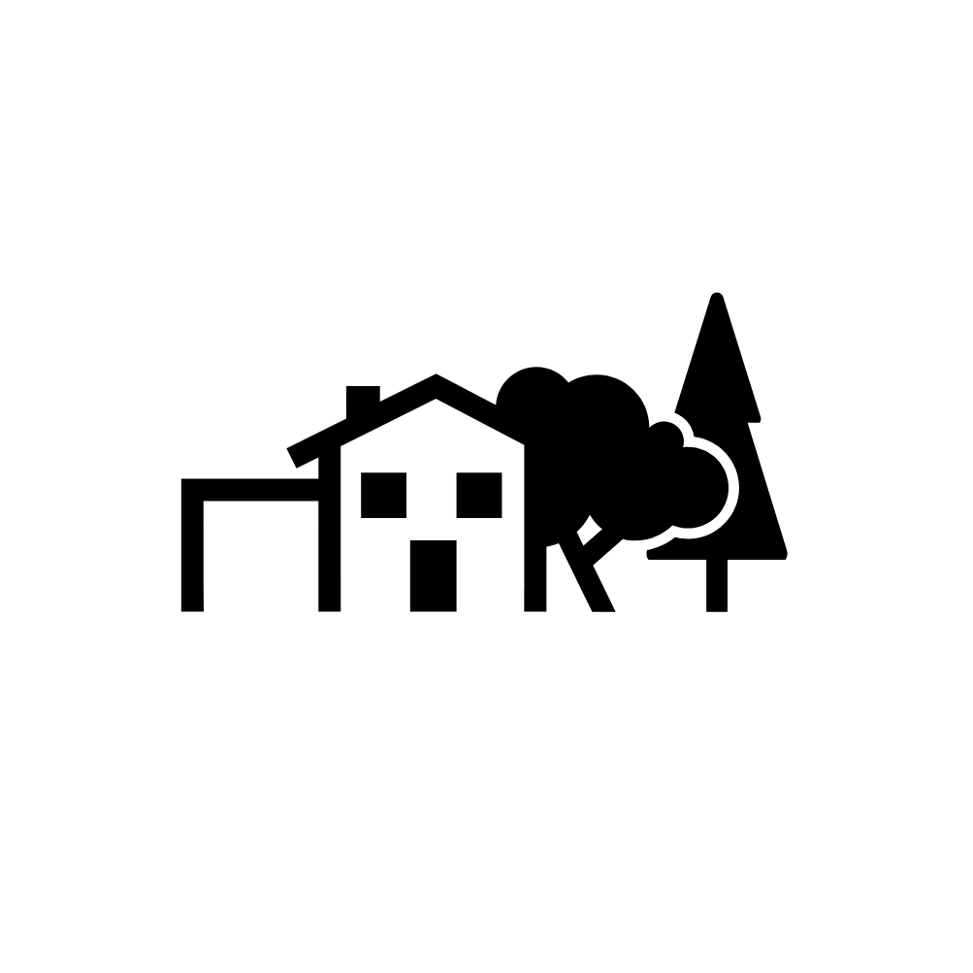
Average Measurements
NYC has an average sound range of 56-95 dB, compared to a range of 62-71 dB in LA and 58-73 dB in Atlanta (UN Environment Programme)
Rural
43 dB
Suburban
49 dB
Urban
59 dB
Notes:
How are you a part of it?
Background on decibels/how sound works, normal levels in rural vs suburban vs city setting
You are living in NYC, loudest city, here’s your participant info
https://www.nytimes.com/2007/07/22/nyregion/nyregionspecial2/22rNoise.html#:~:text=The%20average%20measurement%20in%20urban,and%20in%20rural%20areas%2C%2043.

Slide 7
My Deployment

Slide 8
About My Deployment
Dates
Typical LAeq Levels [Day]
Number of Noise Sources
Location
You reported 5 types of noise: honking, street traffic, music, WWE, yodeling, breathing
Most Common Source of Noise
That’s 12 dB above the recommended level set by the WHO
Typical LAeq Levels [Night]
This was reported 5 out of your 11 noise logs. The 2nd most common complaint was music.
Loudest Day & Time
Reported Noise Logs
That’s 4 dB above the recommended level set by the WHO
The dB this time is 75 dB, 20 dB higher than the ambient noise level during the day
68dB
Five
June 5 - 18, 2022
370 Jay Street,
Brooklyn, NY 11111
Ventilation
11
58dB
Monday, 3pm
Notes:
How are you a part of it?
Background on decibels/how sound works, normal levels in rural vs suburban vs city setting
You are living in NYC, loudest city, here’s your participant info

Slide 9
Time-Series
How does noise vary over time?

Slide 10
Sound Levels over your entire deployment
Time series plot over entire time of deployment
Notes:
Generally this is where all your data is
Most of your data falls into the NORMAL RANGE, with some exceptions reaching MODERATE

Slide 11
Heatmaps
How does noise compare over time?

Slide 12
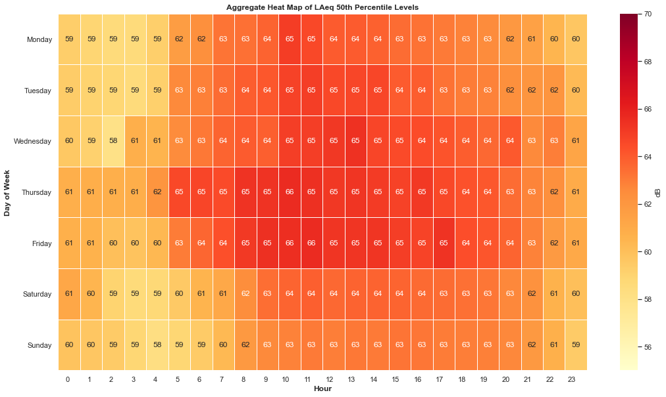
Your average week: How loud is it at each time of day?

Slide 13
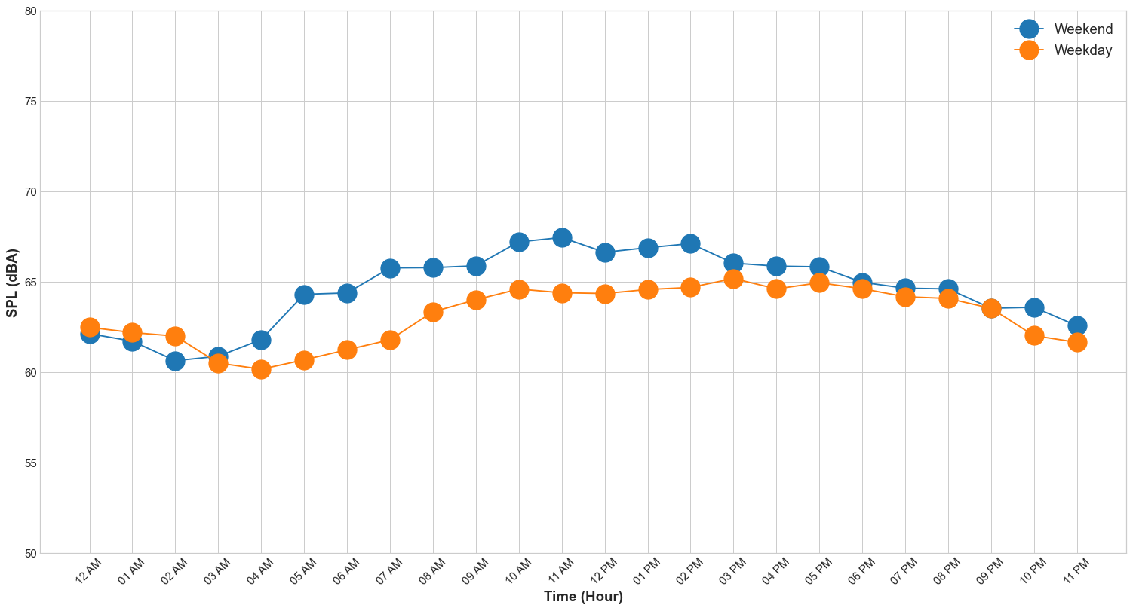
Average Weekdays vs Weekends: How loud is it at each time of day?

Slide 14
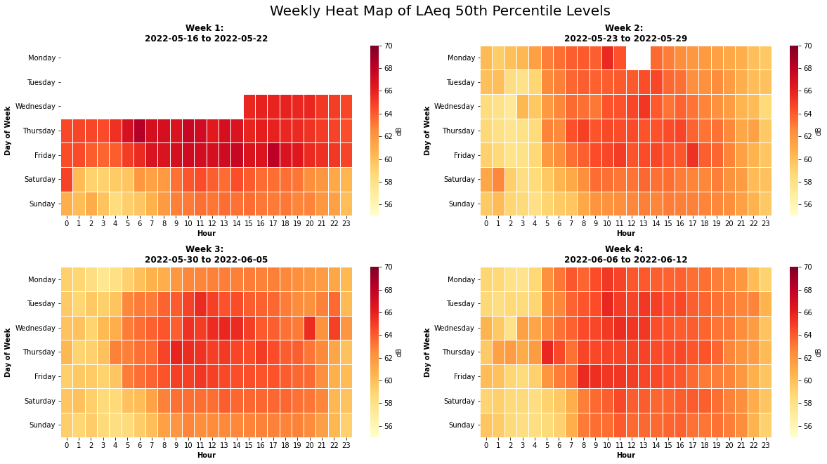
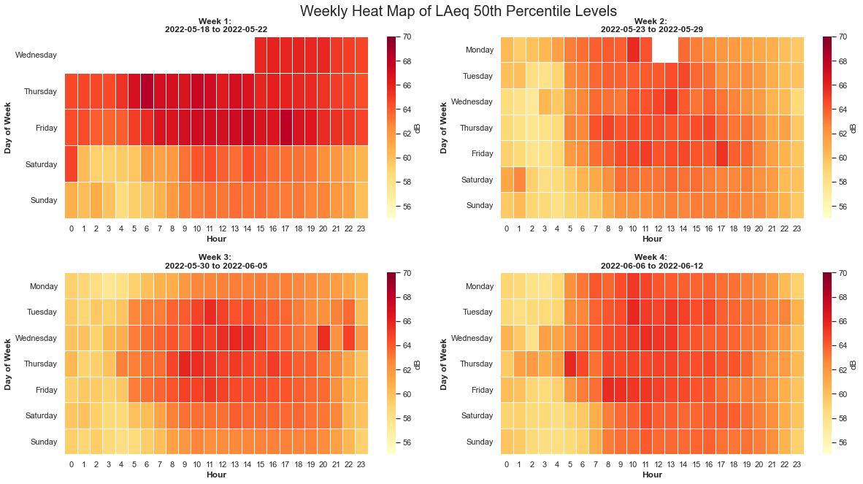
Week by Week: How loud was each day?
Notes:
Takeaway - later starts on weekends
Highlight boxes that they reported in?
Set board black
Need legend to show box report was made in this hour
green?

Slide 15
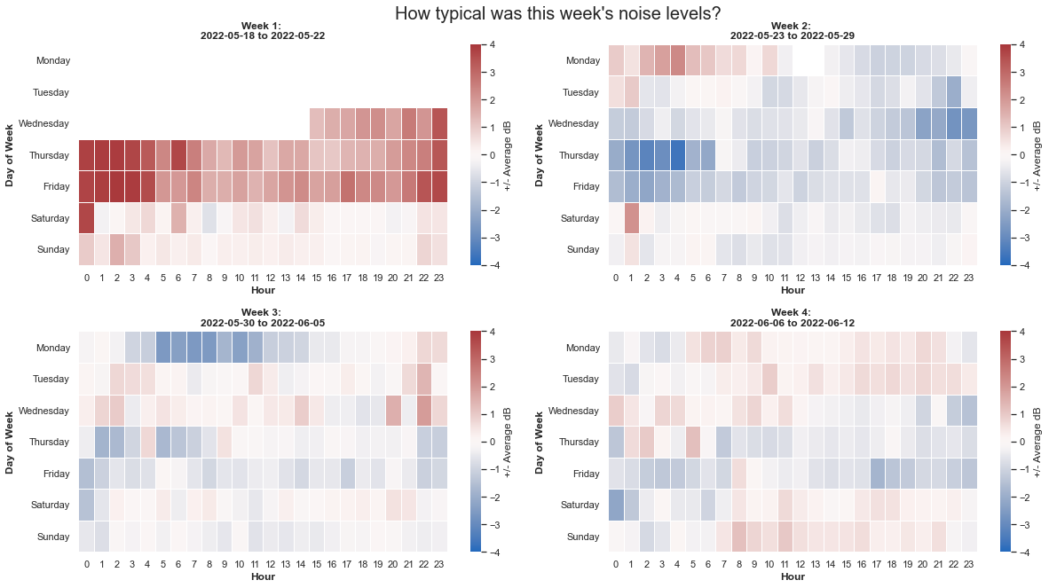
Difference to Average: When was my SPL higher or lower than average?
The difference is calculated by subtracting the average for that time and day of week.

Slide 16
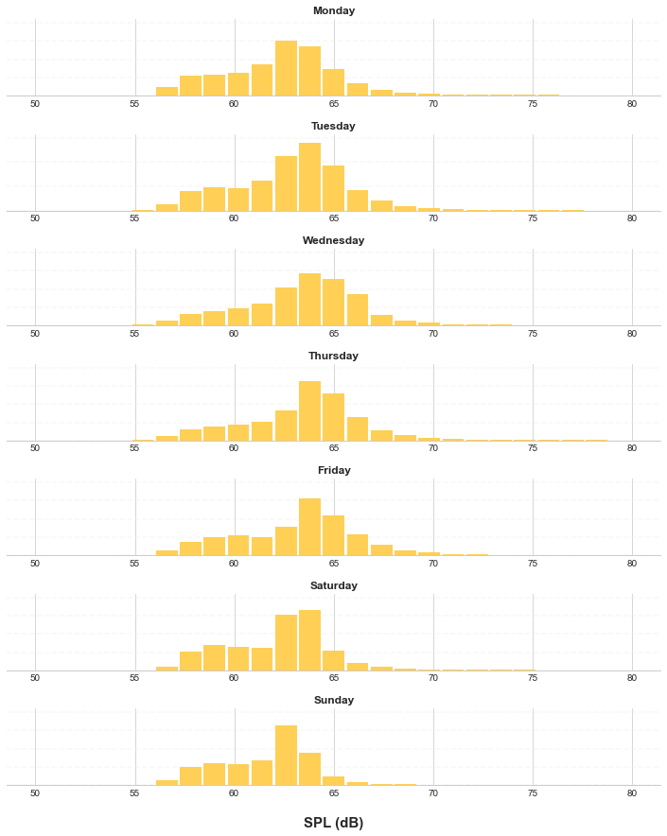
Average Week: What’s the spread of noise on a given day?

Slide 17
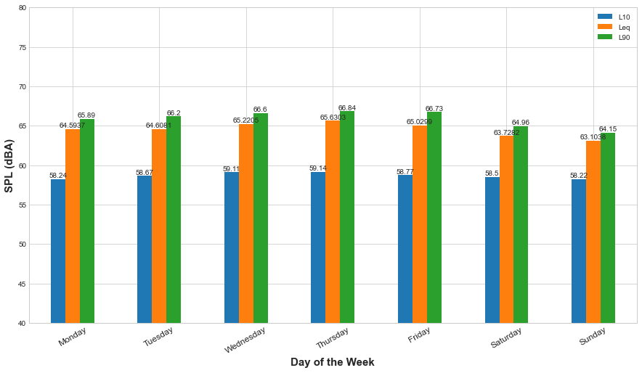
Average Week: What’s the spread of noise?

Slide 18
Your Submitted Reports
How does noise compare over time?

Slide 19
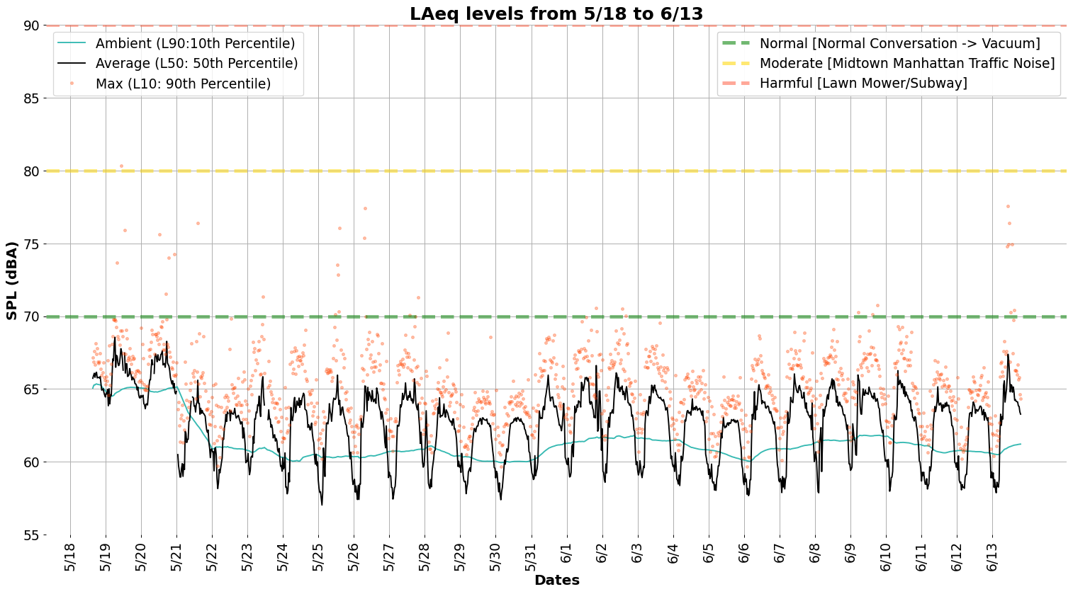

@ 12:45 - construction, jackhammer
@ 12:45 - construction, jackhammer
@ 12:45 - construction, jackhammer
@ 12:45 - construction, jackhammer
@ 12:45 - construction, jackhammer
@ 12:45 - construction, jackhammer

Slide 20
Guide To Terms
Term | Full name | Meaning | Why we monitor it
SPL | Sound Pressure Level | A measure that represents how loud something really is | Human ear hears pressure, not volume. Pressure damages ears
dB | Decibel | A common unit used for measuring SPL - a logarithmic way of describing ratio between 2 sounds | Human ear can hear massive range of sounds- an absolute scale would be too big
Leq | Equivalent Continuous Sound Pressure Level
Notes:
“When it comes to measuring the intensity of a sound wave, two different metrics can be uses. The first is called "sound pressure," which is a measure of the deviation from the ambient air pressure, typically measured in pascals (Pa). But a more common metric is called "sound pressure level." This is a logarithmic measure of the effective pressure of a sound wave relative to a known reference value (typically 20 micropascals, which is the threshold of human hearing). This quantity is often abbreviated "SPL," meaning sound pressure level, and measured in decibels (dB).
When someone asks, "What is SPL?" the simplest answer might be that it is a logarithmic scale used to measure the loudness of a sound relative to the quietest sound that humans can hear. A logarithmic scale is a nonlinear scale which is adjusted by factors of 10. Because the human ear is so sensitive, and because we can detect such a large range of air pressure deviations, it makes sense to measure sound using a logarithmic scale. In factor, SPL is the standard way to measure the volume of a sound in science, medicine, and even the music industry.” https://study.com/learn/lesson/sound-pressure-level-movement-examples.html
https://blog.teufelaudio.com/sound-pressure-human-hearing-perceived-volume/
https://www.ncbi.nlm.nih.gov/books/NBK207834/
Db asterisk all db levels are measured in dbA
Potential fact sheet at the end -reproducibility report

Slide 21

thanks!
ask@sonycproject.com
+1 111 111 1111
https://wp.nyu.edu/sonyc/
SONYC Website
Digital Version
DEP Links(?) 311 app, etc?

